Slide 1

CartoonGAN: Generative Adversarial Networks for transfer human face
Author: Yang Chen, Yu-Kun Lai , Yong-Jin Liu
Publish: CVPR 2018
第二十組
0657226 陸建利
A053095 林柏淵

Slide 2
Outline
What is CartoonGAN
Problem definition
Significance contribution
CartoonGAN architecture
Result and experiment

Slide 3
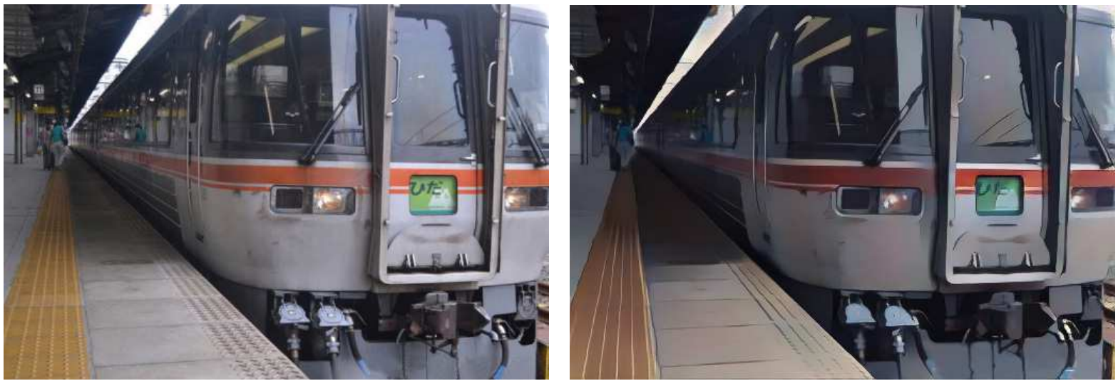
What is CartoonGAN
propose a solution to transforming photos of real-world scenes into cartoon style images, which is valuable and challenging in computer vision and computer graphics.
origin
after transfer
Figure 1. the picture shows a real-world scene from “your name ”whose corresponding cartoon image

Slide 4
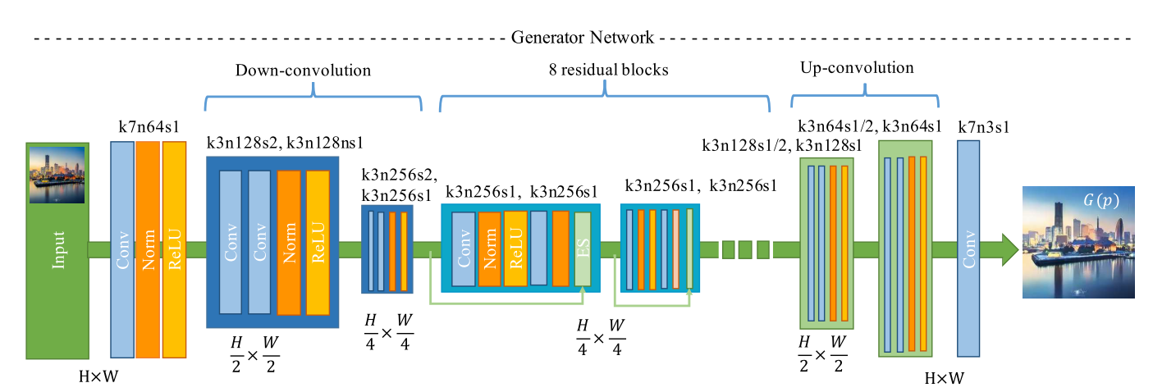
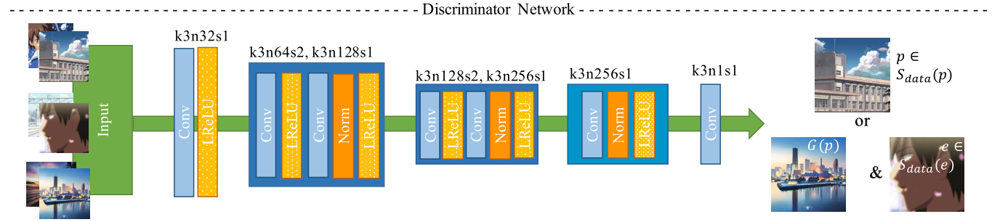
CartoonGAN architecture
Generator (G)
Discriminator (D)

Slide 5
CartoonGAN architecture
Generator (G)
Generator output
(real world photo with cartoon style)
Real world photo from camera

Slide 6
CartoonGAN architecture
Generator (G)
encode

Slide 7
CartoonGAN architecture
Generator (G)
Construct target manifold

Slide 8
CartoonGAN architecture
Generator (G)
reconstruct

Slide 9
CartoonGAN architecture
Discriminator input:
Real world photo
Generator output
Cartoon image with edge clear
Discriminate these three kind of image

Slide 10

Loss function
Adversarial loss:
To drives the generator network to achieve the desired manifold transformation.
Semantic content loss:
To preserves the image content during cartoon stylization
Notes:
表面上看这个的意思是，
D要让这个式子尽可能的大，也就是对于x是真实分布中，
D(x)要接近与1，对于x来自于生成的分布，D(x)要接近于0，
然后G要让式子尽可能的小，让来自于生成分布中的x，D(x)尽可能的接近1

Slide 11
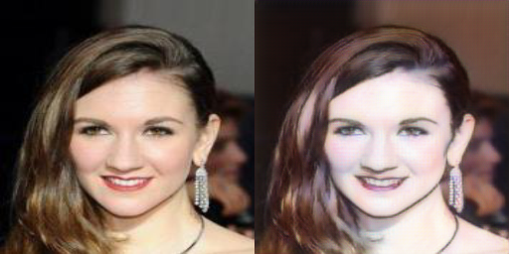
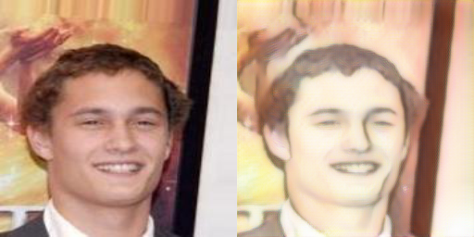
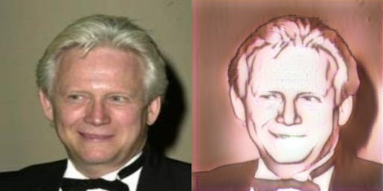
Weight ω
The bigger the ω is
The more content it preserve
ω = 12
ω = 7
ω = 2

Slide 12
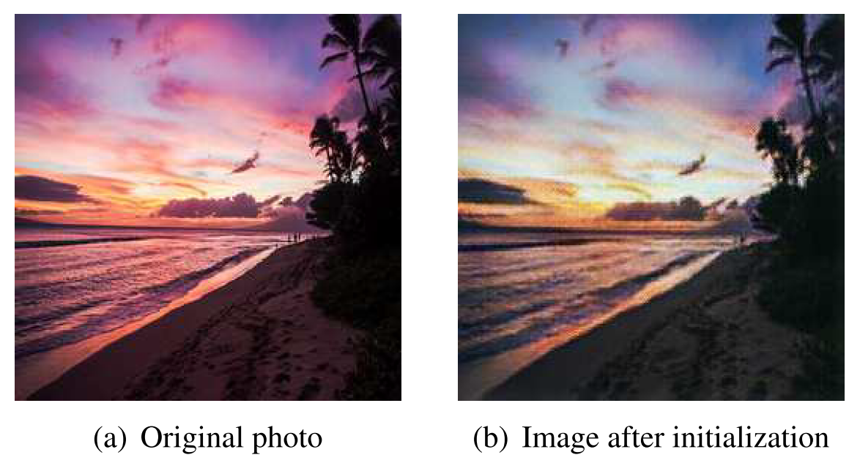
Initialization phase
GAN model problem:
highly nonlinear,
with random initialization
optimization can be easily trapped at suboptimal local minimum.
Hard to converge
Solution:
pre-train generator G with only the semantic content loss L_{con} (G, D) about 10 epoch.

Slide 13
Experiments
Device:
TESLA K80 GPU x 2
TESLA P100 GPU x1
Data source:
Human face dataset about 20000 from CelebA
About 6000 cartoon image dataset from four animate produced by Kyoto Animation.

Slide 14


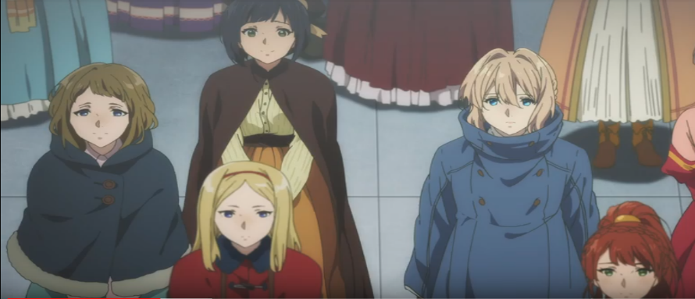
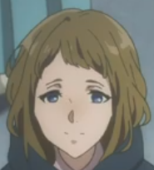
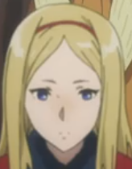
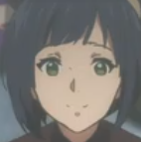
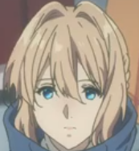
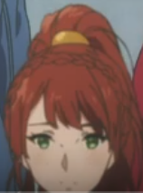
Pretreatment for cartoon data
Video-to-image
converter
Anime-face recognizer
Anime-face extractor and resize
Transfer video from mkv format to png format.
Fetch the face of all characters.
Filter out the image which is smaller 128x128
Resize all image to 256x256

Slide 15
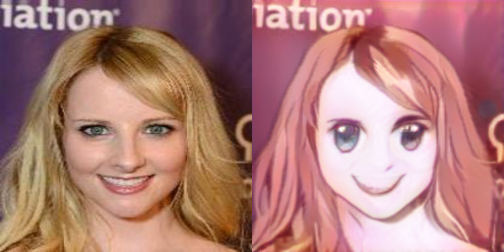
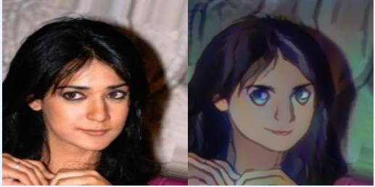
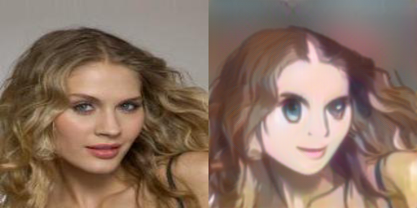
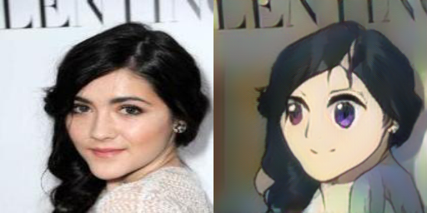
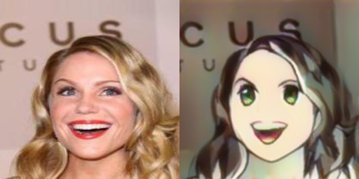
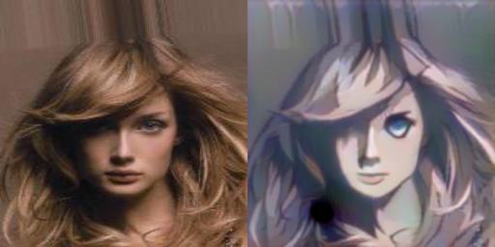
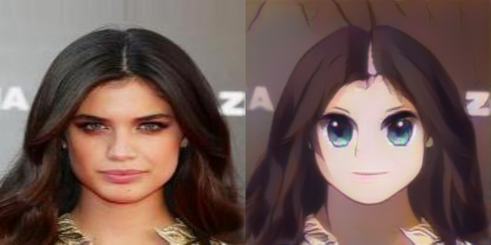
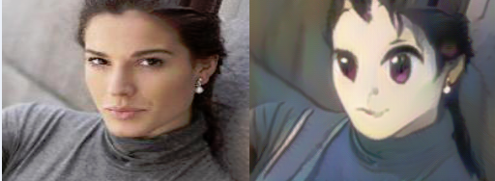
Result transfer with Kyoto Animation.
Style Kyoto Animation.

Slide 16
Demo video

Slide 17
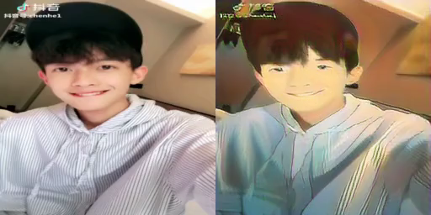
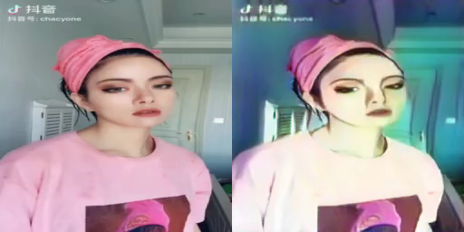

Slide 18
Thank you

